Slide 1

Welcome to Minet Junior School

Slide 2
What will be covered during this meeting?
School expectations
Curriculum coverage
PE and uniform
Homework and lunches
Website and important forms

Slide 3
School values, behaviour and expectations
We teach our pupils about behaviour for learning through the school values – the 6Rs - and all pupils are expected to abide by these:
READY TO LEARN - motivation, curiosity, self-confidence
RESPONSIBLE - empathy towards other learners, making the best of learning opportunities, self-awareness, calm and sensible
REFLECTIVE - looking back and learning, asking questions
RESILIENT - keeping going, managing distractions, managing our feelings
RESPECTFUL - runs through everything we do; respecting yourself, each other and the environment; having good manners and following the class code of conduct.
REMARKABLE - anything that goes over and about what is expected of them in all areas of the school.

Slide 4
At Minet we expect all our pupils to:
Behave in accordance with the school’s behaviour policy and be courteous towards others
Arrive in school on time each day – 8.40am for a soft start
Dress in smart full school uniform and PE kit
Work hard and do their best in all lessons
Complete homework to a good quality and hand it in on time

Slide 5
Our Curriculum – Autumn Term
English | Stone Age Boy UG - Boy Genius of the Stone Age Instructions Recount Character/Setting Description | Skara Brae Stone Age Boy Non-Chronological Report Story Writing Letter Writing Poetry
Grammar | Adverbs to express time, cause and place Past tense verbs Prepositional phrases | Use headings and subheadings Multi clausal sentences Detail add emotional language
Spelling | U sound spelt ou Adding suffixes Prefix un | Prefixes dis and mis Prefix re Recapping prefixes and suffixes
Mathematics | Place value Addition/subtraction | Addition/subtraction Multiplication and division
Science | Animals including Humans | Rocks and Soils

Slide 6
Religious Education | Hinduism | The Christmas Story Christianity
PSHE | Being me in my world | Celebrating differences
Computing | Online safety Spreadsheets | Touch typing Coding
Creative Curriculum | The Stone Age to the Iron Age
PE | Football, Basketball, Gymnastics and Tag Rugby
Music | Environment – Exploring songs and poems about places
French | Spoken and written French

Slide 7
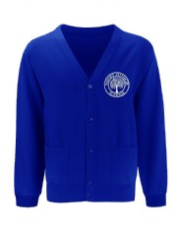
Uniform
All uniform items can be bought online through our school website. Please use the following link https://www.minetjunior.org.uk/uniform/
Uniform - Girls
Uniform - Boys
Plain white cotton shirt
School tie
A blue school jumper or cardigan
Black skirt or trousers
White socks or black tights
White/blue/black hijab (if applicable)
Flat black shoes (no trainers)
School colour hair band
Plain white cotton shirt
School tie
A blue school jumper (with the school logo)
Black trousers
Black or grey socks
Black patka (if applicable)
Flat black shoes (no trainers)
All uniform can be purchased through Mapac online.

Slide 8


PE Kits
Bring your kits in on a Monday and
home on a Friday.
Ready for your PE lessons and clubs.
Please make sure these are labelled
Reminder to help teach your children how to get dressed independently.
White t-shirt, blue/black shorts (joggers)
Please practise getting dresses with your children at home.

Slide 9
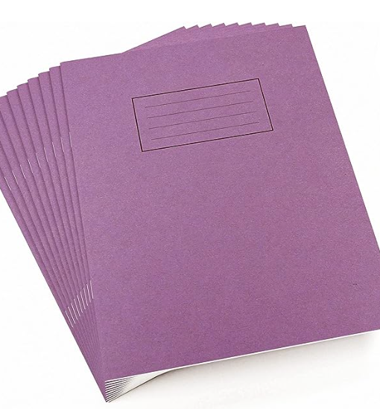
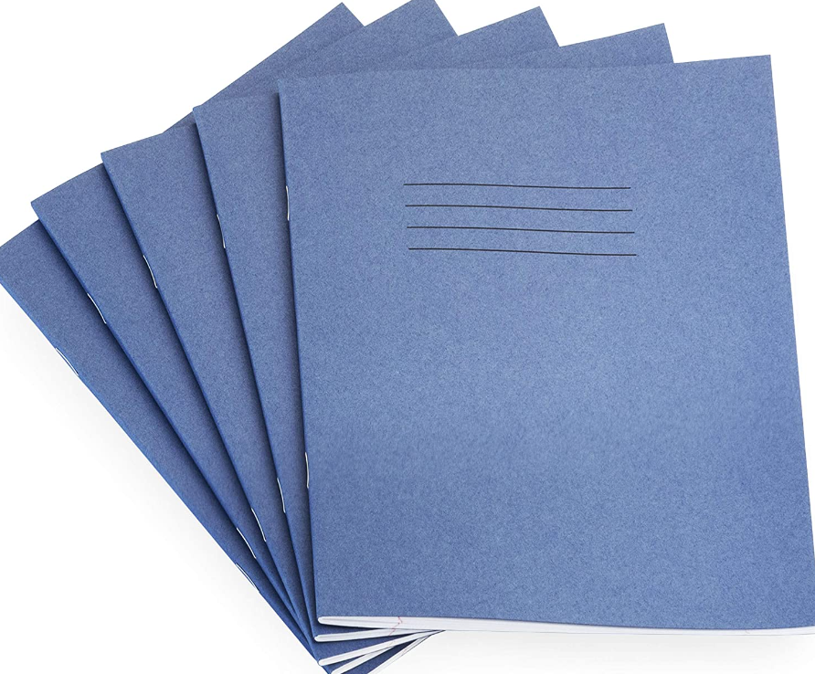
Homework
Homework will go out on Mondays and collected on Fridays.
English
Maths
Everyone must read for at least 10 minutes every day and record it into the school reading diary.

Slide 10
Lunches
Lunches are FREE but they must still be booked so that your child enjoys a meal of their choice.
A healthy lunch may include:
Sandwiches
Pasta
Rice
Fruit
Yogurt
Vegetables
X1 biscuit
What should not be included:
Sweets
Fizzy drink
Donuts
Nutella
Nuts
Chocolate bars

Slide 11
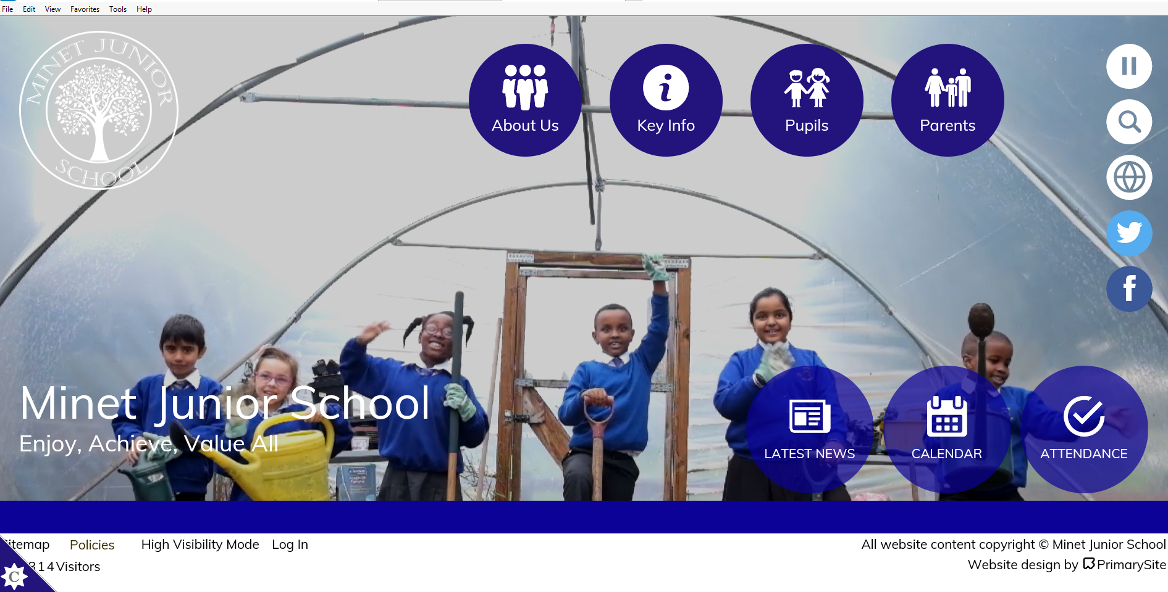

Slide 12

Thank you !

