Slide 1
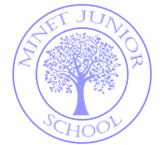
Welcome to Year 5
2026-2027

Slide 2
Today’s Meeting Agenda
Year 5 team
School expectations
Curriculum coverage
Homework, PE/swimming and uniform
Trips and workshops

Slide 3
Year 5 Teaching Team
In Year 5, we have highly trained and committed staff whose job it is to make sure that your child receives the best possible education at Minet Juniors.
Mrs Dupree – Head of Year 5/5D Class Teacher
Ms Moxon/Miss Cooper– 5CM Class Teachers
Mrs Rizwan – 5R Class Teacher
Mrs Hall - HLTA for all classes
Ms Johnston – TA
Mr Talwar - TA

Slide 4
Senior Leadership Team
Ms Ryan – Head Teacher
Miss Gubbin – Deputy Head Teacher
Mrs Taylor – Assistant Head (Inclusion and Child Protection)
Miss Molloy – Assistant Head (Teaching and Learning)
Also: Miss Elderfield - SENDCo
Miss Cooper – Behaviour Lead

Slide 5
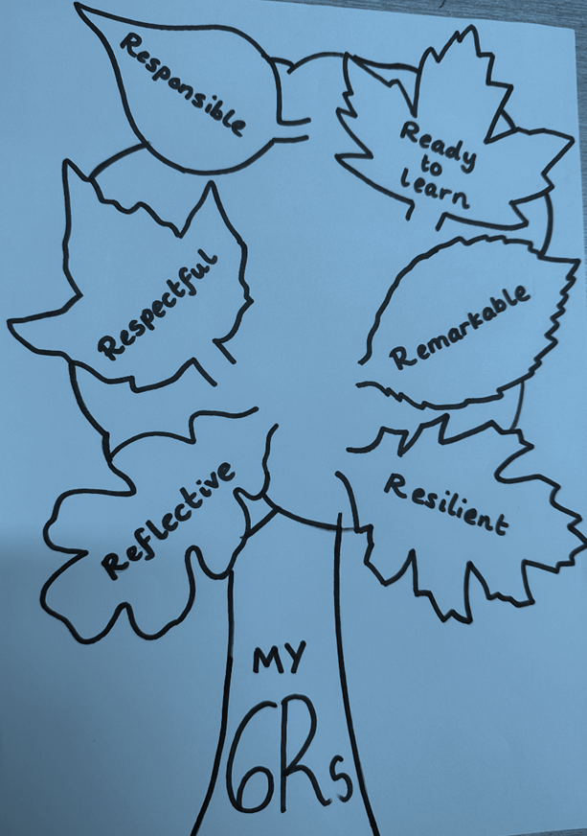
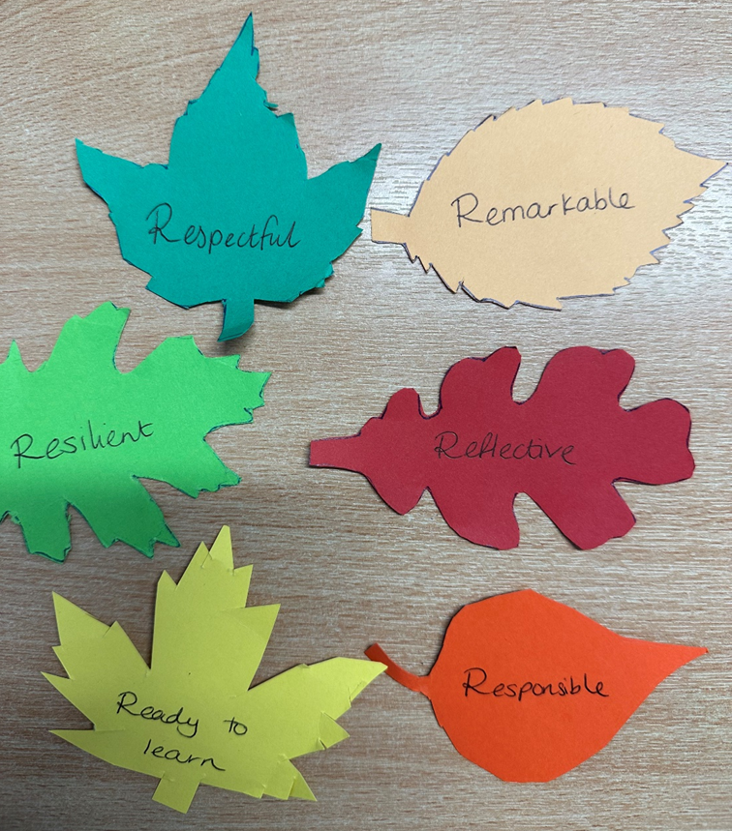
School values, behaviour and expectations
Children will receive a ‘Leaf stamp’ sheet in which they will ‘collect’ their leaves during the year.
Any member of the staff can give a child a leaf and these will be announced and celebrated every week at the Merit assembly.

Slide 6
Curriculum Information
English, including Guided Reading, happens daily. We are currently reading How To Train Your Dragon which is our key text.
Mathematics happens daily. We are currently studying place value.
Science is currently The Earth and Space and is taught for 2 hours a week.
Topic is currently The Vikings and is also taught for 2 hours a week.
Computing is taught weekly and this term the children will be decoding.
All communication will be via parent pay so please check your emails regularly.

Slide 7
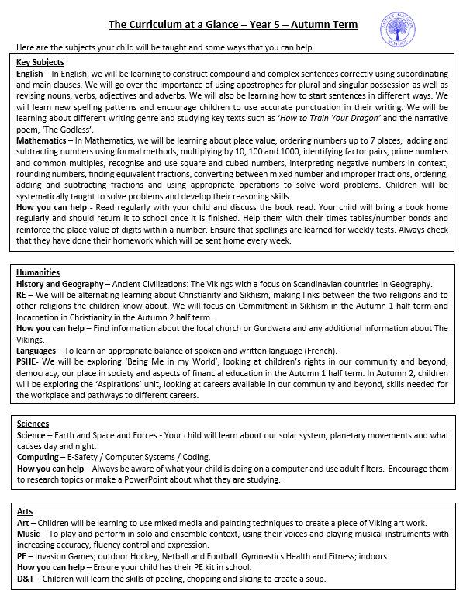
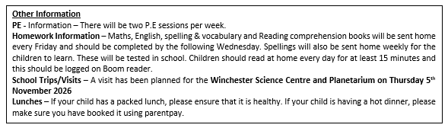
Curriculum Overview
Each term an overview of what will be covered in each subject will be added to the website.
The overview shows what we will be teaching in each topic and has additional information on how to support your child at home.

Slide 8
Support
Year 5 classes currently have Teaching Assistants who provide pupils with additional support and run interventions.
There is also a Higher Level Teaching Assistant who works in the year group who also provides support in class and runs interventions.
Interventions are carefully monitored and designed to address any gaps in learning.

Slide 9
PE
Your child has PE twice per week. All children should have a full P.E kit in school all week.
On P.E days, your child should come to school in school uniform as usual.
Children will be going swimming next half term. Children will go swimming for one hour every day for six days.
(More information to follow nearer the time.)

Slide 10
Home Learning
Homework is a key element of success in year 5. Not only does it secure in class learning, it helps children to develop the necessary study skills required for Year 5.
Homework books are sent home on a Friday and should be completed by the following Wednesday . This will be monitored by the class teacher and reviewed in class with the children. Your child will bring home a Maths, English, spelling & vocabulary and Reading comprehension book each week.
Spellings – Spellings are sent out every Friday and children are tested the following week. Please practice these regularly.
Times tables – Please ensure your children know their times tables.
It is vital that your child completes his/her homework.

Slide 11

Reading – EVERY DAY (At least 15 minutes and parents to ask questions to support understanding) Daily reading should be recorded by parents on the ‘Boom Reader’ website.

Slide 12

Website
The Year 5 page is updated regularly with work completed in school, trip write ups or workshops that the children have had.
Knowledge Organisers and key information are also on the relevant year group pages.

Slide 13
Uniform - Girls
WHITE SHIRT
SCHOOL TIE
SCHOOL CARDIGAN
BLACK SKIRT/TROUSERS
BLACK TIGHTS/WHITE SOCKS
BLACK SHOES (NO TRAINERS)
WHITE HIJAB (IF APPLICABLE)
School uniform can be ordered from the office.

Slide 14
Uniform - Boys
WHITE SHIRT
SCHOOL TIE
SCHOOL JUMPER
BLACK TROUSERS
BLACK/GREY SOCKS
BLACK SHOES (NO TRAINERS)
School uniform can be ordered from the office.

Slide 15
Trips and Workshops
Trips or workshops are organised to reinforce and extend the learning in the classroom.
When a trip is planned, the letter and payment will be through Parent Pay.
This term we will be visiting the Winchester Science Centre and Planetarium – you will shortly receive a letter informing about this trip.
Spring Term – to be confirmed.
Summer Term – Trip to the Gurdwara.

Slide 16

Breakfast club

Slide 17
Concern’s Procedure
If you have a concern then the first person contact is the class teacher.
If you are still not happy, then contact the Year Leader.
If you continue to have concerns, you can ask to speak with a member of SLT.
As a rule, things never reach this stage and any issues are immediately resolved at stage one.

Slide 18

Question Time
If you have any further questions then please feel free to speak to your child’s class teacher now…
Thank you for coming and we look forward to a successful year with our Year 5’s.

