Slide 1

Year 4
Meet the Teacher
Tuesday 17th September 2026

Slide 2

What will be covered during this meeting ?
Year 4 team
School expectations
Curriculum coverage
Homework, PE and uniform
How you can support your child

Slide 3

Year 4 staff
In Year 4, we have highly trained and committed staff whose job it is to make sure that your child receives the best possible education at Minet.
Miss Islam– Head of Year 4
4R – Miss Rhatigan
4S – Mrs Sangha
Ms Wright– HLTA
Ms Said-Teaching Assistant
Miss Burke- Teaching Assistant

Slide 4
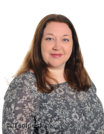
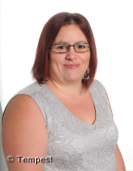
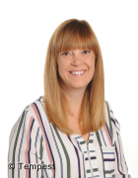
SENIOR Leadership Team
Ms Ryan – Head Teacher
Miss Gubbin – Deputy Head Teacher
Mrs Taylor – Assistant Head Teacher (Inclusion & SENDCO)
Ms. Molloy-Assistant Head Teacher (Teaching and Learning)
Miss Elderfield – SENDCO
Miss Cooper – Head of Behaviour

Slide 5
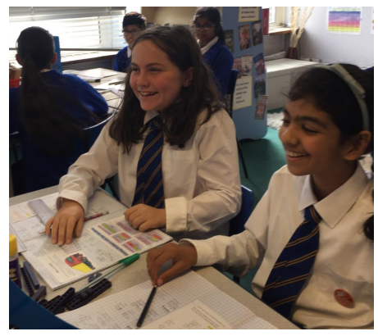
School values, behaviour and expectations
We teach our pupils about behaviour for learning through the school values – the 6Rs - and all pupils are expected to abide by these:
READY TO LEARN - motivation, Curiosity, Self-Confidence
RESPONSIBILITY- empathy towards other learners, making the best of learning opportunities, self-awareness, calm and sensible
REFLECTIVITY- looking back and learning, asking questions
RESILIENCE- keep going, managing distractions, managing our feelings
RESPECT - runs through everything we do; respecting yourself, each other and the environment; having good manners and following the class code of conduct.
REMARKABLE – making the extra effort in classwork, homework, dressing smartly in uniform, being an incredible friend in school, going above and beyond in everything they do.
Notes:
Kirstie

Slide 6
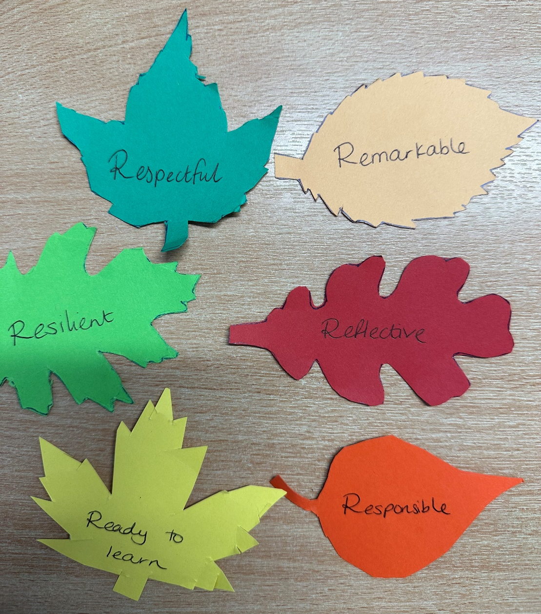
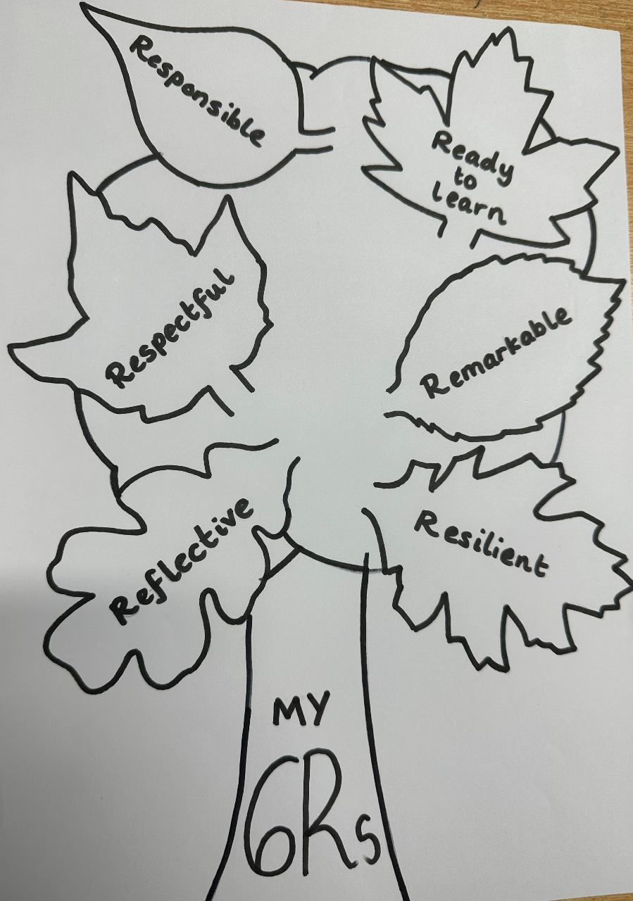
Leaf Stamp
Your child will get their own ‘leaf stamp’.
Throughout the year you can add their leaves which they will be able to show in assembly on the last day of school.
Notes:
Kirstie

Slide 7
School values, behaviour and expectations
At Minet we expect all our pupils to:
Behave in accordance with the school’s behaviour policy and be courteous towards others
Arrive in school on time each day – 8.45am
Dress in smart full school uniform and PE kit
Work hard and do their best in all lessons
Complete homework to a good quality and hand it in on time
Notes:
Rav

Slide 8
School values, behaviour and expectations
Rewards and sanctions
All pupils learn differently and at Minet we recognise each individual’s efforts and achievements and reward these in various ways:
Verbal praise for their hard work and good behaviour
Weekly celebration assembly certificates, pen licences and leaves
Termly attendance certificates
House points
If you wish to discuss an incident or your child’s behaviour in general, your first port of call is always the class teacher.
Year Leader – Miss Islam
Assistant Headteachers – Mrs Taylor & Miss Molloy
Headteacher – Ms Ryan
Notes:
Rav

Slide 9
Curriculum overview - Autumn
English | Escape from Pompeii Narrative – (focus on description) Newspaper Report | The Roman Mysteries II - The Secrets of Vesuvius Narrative – Diary Poetry – Rome/PompeiI
Spellings | Year 3/4 spelling words | Year 3/4 spelling words
Maths | Place value Addition/Subtraction | Measurement – Length Multiplication and Division
Science | Living Things and their Habitats | Animals including Humans

Slide 10
Curriculum overview - Autumn
Creative Curriculum | The Romans
R.E. | Judaism Beliefs and Practices | Christianity Incarnation and Christmas
Computing | Online Safety Touch typing | Programming - sequencing sounds OR Computing systems and networks - connecting computers
P.S.H.E. | Being in my world | Celebrating differences
P.E. | Football and Basketball | Gymnastics and Hockey
Notes:
Rav

Slide 11

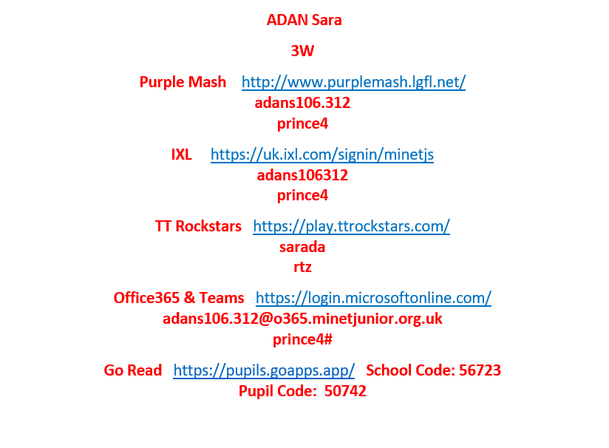

Homework
Children will receive 1 piece of English, Maths, and a Reading Comprehension every week.
Online learning will be expected:
IXL
Boom Readers/Go Read
Times Tables Rock Stars
Reading every day with an adult for approximately 10-15 minutes recorded in your child’s reading record.
Spellings (10 words given and tested every week). Given on a Friday, tested the following Friday.
Additional research projects or tasks related to topic may occasionally be set.
Homework will be set on a Wednesday and due back in the following Wednesday.
Notes:
Kirstie

Slide 12
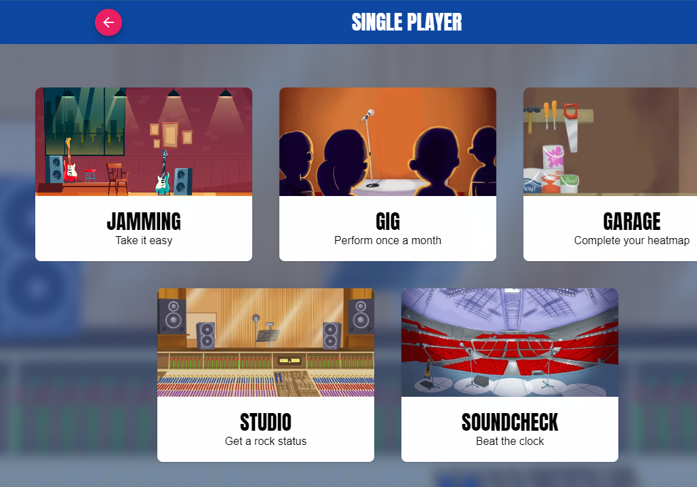
MTC
The MTC or Multiplication Tables Check is a government test that all Year 4 complete.
It takes place in the month of June and comprises of 25 multiplication questions.
Children are given 6 seconds to read and answer the question. It is completed on a computer.
It is important that children learn and know their times tables. Practising TTRS (times tables rock stars) is essential. The Sound check option is the closest thing to the actual test there is.
Our first, unofficial mock test will begin second week of October just to see where the children are and which times tables will be needed to practice.
Notes:
FI

Slide 13
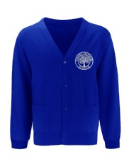
Uniform - Girls
Uniform - Boys
Plain white cotton shirt (with a turn down collar)
School tie
A blue V-Neck school jumper or cardigan (both with the school logo)
Black skirt or trousers
White socks or black tights
White hijab (if applicable)
Flat black shoes (no trainers or boots please)
Plain white cotton shirt (with a turn down collar)
School tie
A V-Neck blue school jumper (with the school logo)
Black trousers
Black or grey socks
Black patka (if applicable)
Flat black shoes (no trainers or boots please)
During the summer term girls may wear a blue gingham dress (with white tights if applicable for religious reasons)
During the summer term boys may wear black shorts.
All uniform items can be bought online through our school website. Please use the following link https://www.minetjunior.org.uk/uniform/
All uniform can be purchased through Mapac online.
Notes:
FI

Slide 14
Trips and Workshops
Trips or workshops are organised to act as a hook or inspiration at the beginning or end of a topic to enhance educational opportunities.
When a trip is planned, the letter and payment will be through Parent Pay.
This term we will be visiting Ufton Court to link with our Roman topic – more information will follow soon.
Notes:
FI

Slide 15



Physical Education
At Minet, PE is taught by our fully qualified sports coach - Mr Howell. PE is taught on a Tuesday and Thursday.
(these days may change every second half term)
Please ensure your child brings in their correct PE kit in school - blue shorts, white t-shirt and trainers. Children can have dark coloured jogging bottoms during the Autumn term.
Notes:
Kirstie

Slide 16

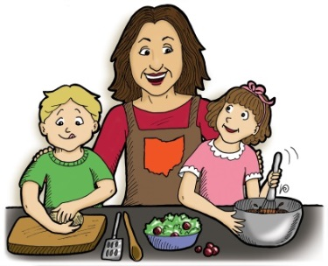

How can you support your child?
Read with them and hear them read regularly – ask questions; sign and comment on their reading in the reading record
Find ways of supporting them with their homework, including days out, discussions, bringing an object in.
Check that your child is equipped and ready for school each day, e.g. correct uniform, PE kit, stationery
Stationery – pencil, rubber, glue stick, sharpener
Ask them about their day and their learning.
Notes:
FI

Slide 17
Just a few reminders:
End of day pick-up
Attendance and absence
Healthy lunch and fruit snack

Slide 18

Thank you for listening

